Slide 1
Testing multiple combinations of outputs from BERT’s encoders in BERTopic topic modeling
Author: Dominik Koterwa

Slide 2
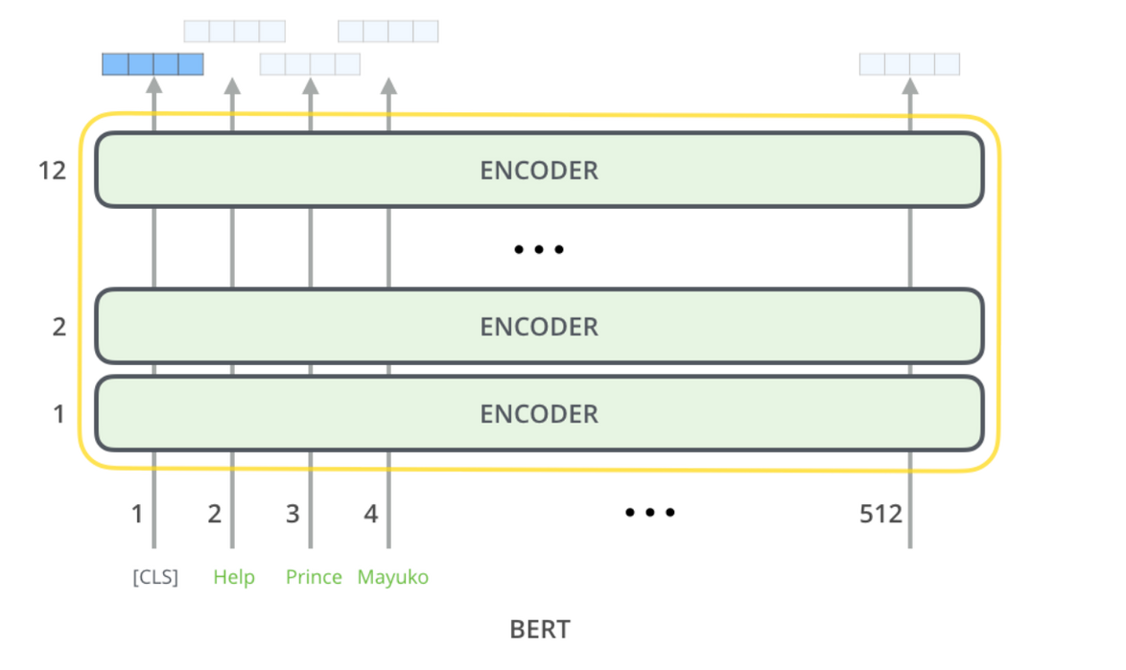
Quick intro
BERTopic is built using BERT, which is a model constructed from Encoder part of traditional Transformer. However, to provide a higher efficiency, BERT is a stack of 12 Encoders.
The output of each Encoder can be used as a representation of a sentence
Usually, people use the output for the CLS token from the last Encoder
This is the same case with BERTopic. It operates on the CLS token from last Encoder and then uses it for topic modeling
Source: http://jalammar.github.io/illustrated-bert/

Slide 3
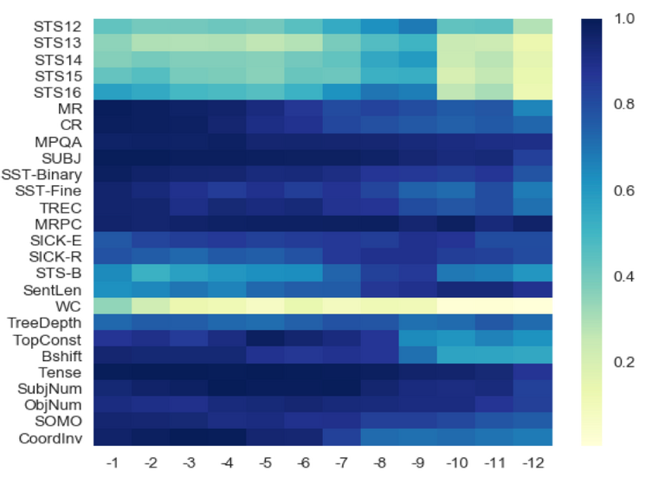
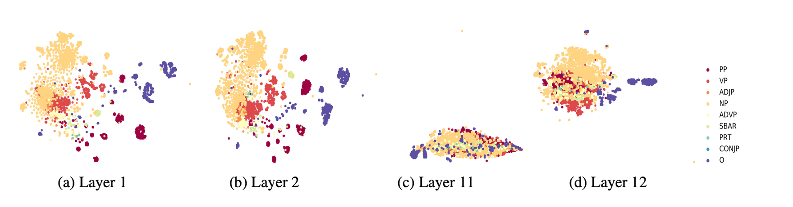
Research about output of Encoders
A large portion of research has been made in order to investigate the linguistic properties of BERT’s activations from different layers. It has been stated that in the first layers model concentrates knowledge about structural/syntactic features of the input. However, in next layers, this knowledge is replaced with higher concentration on semantics/task specific features.
Source: Ma et al., 2019
Source: Jawahar et al., 2019

Slide 4
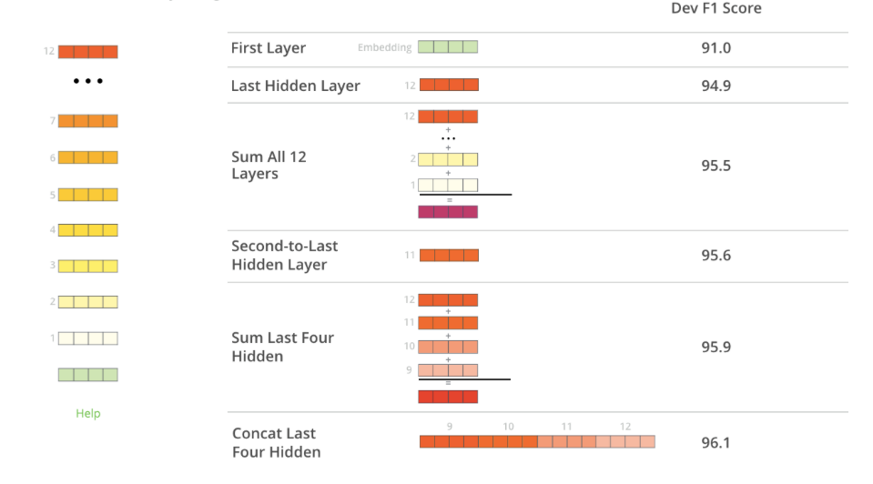
BERT’s authors also analyzed that
Results on CoNLL-2003 Named Entity Recognition task
Source: http://jalammar.github.io/illustrated-bert/

Slide 5
In BERTopic, CLS token from last layer is being used as a representation of input sequence.
The question is how different types of representations affect the quality of BERTopic? In this research I test 18 of them.

Slide 6
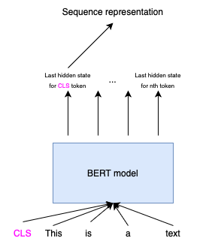
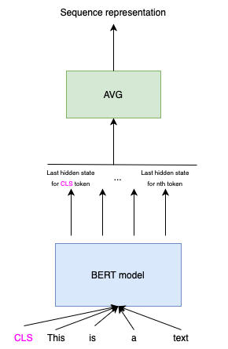

Quick introduction to best-known pooling methods
CLS Pooling
Mean Pooling
Max Pooling

Slide 7
Description of experiments
I chose the dataset of Trump’s tweets, because it is a common benchmark for topic modeling and was used in BERTopic paper.
Used “all-MiniLM-L12-v2" Sentence Transformer to produce embeddings.
18 different types of embeddings (6 types of aggregation * 3 types of pooling) have been collected.
Then, I used Trainer provided by the BERTopic’s author to conduct evaluation.
Topic Coverage and Topic Diversity measures have been used to compare the quality of vaious options.

Slide 8
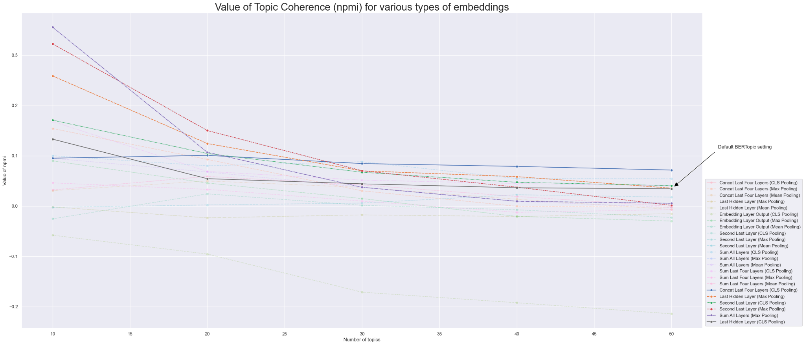
Results on Trump Tweets dataset (1)

Slide 9
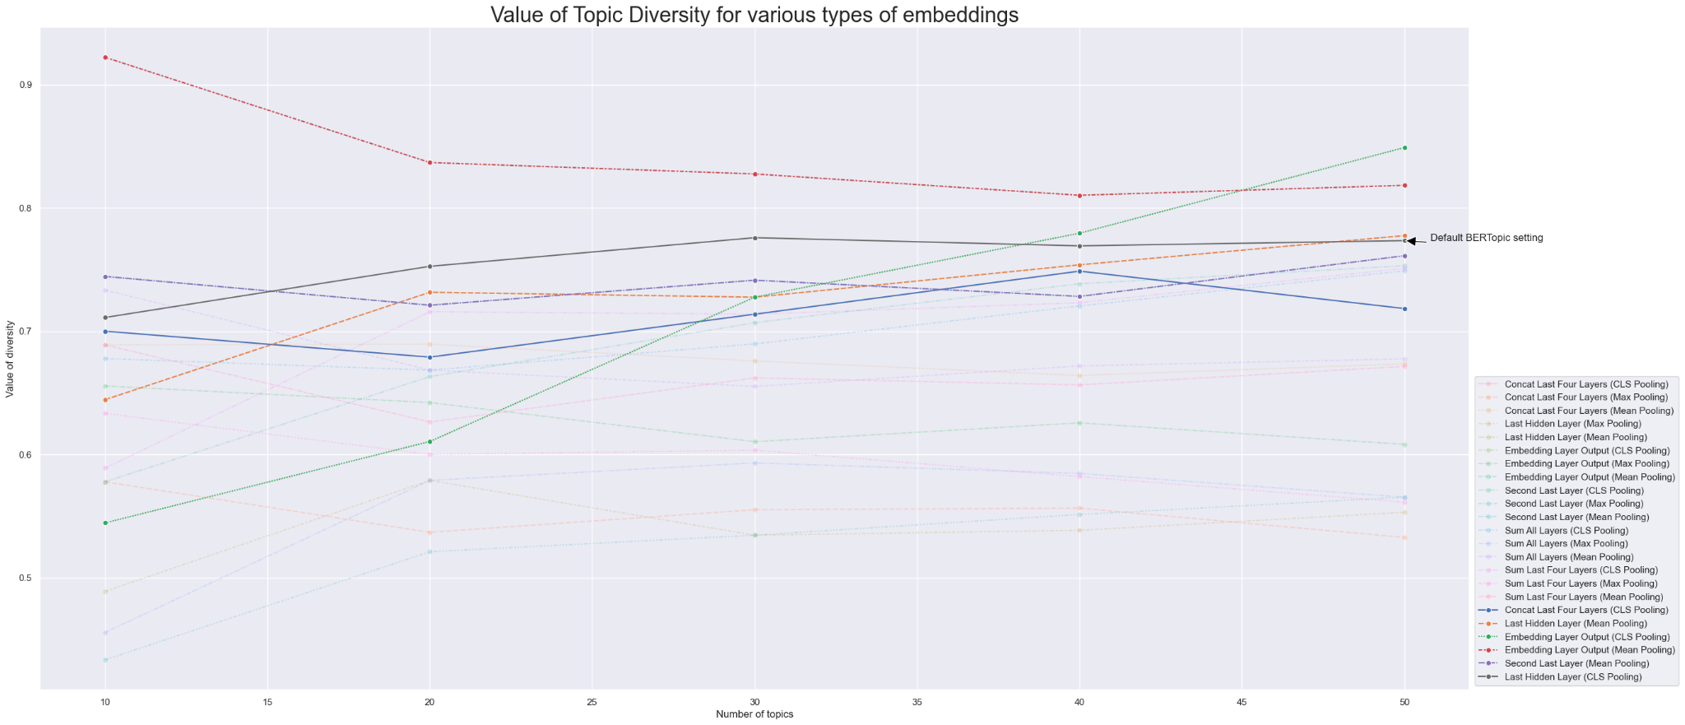
Results on Trump Tweets dataset (2)

Slide 10
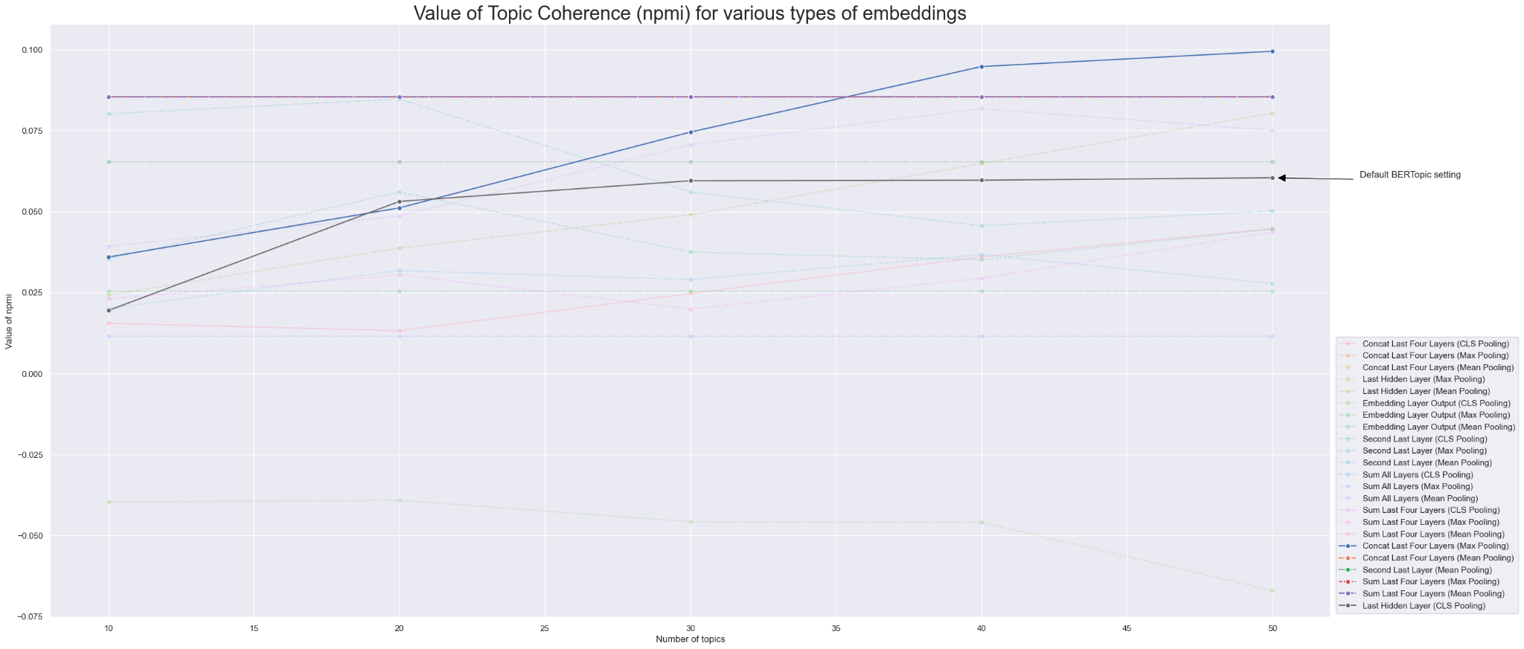
Results on 20 News Groups dataset (1)

Slide 11
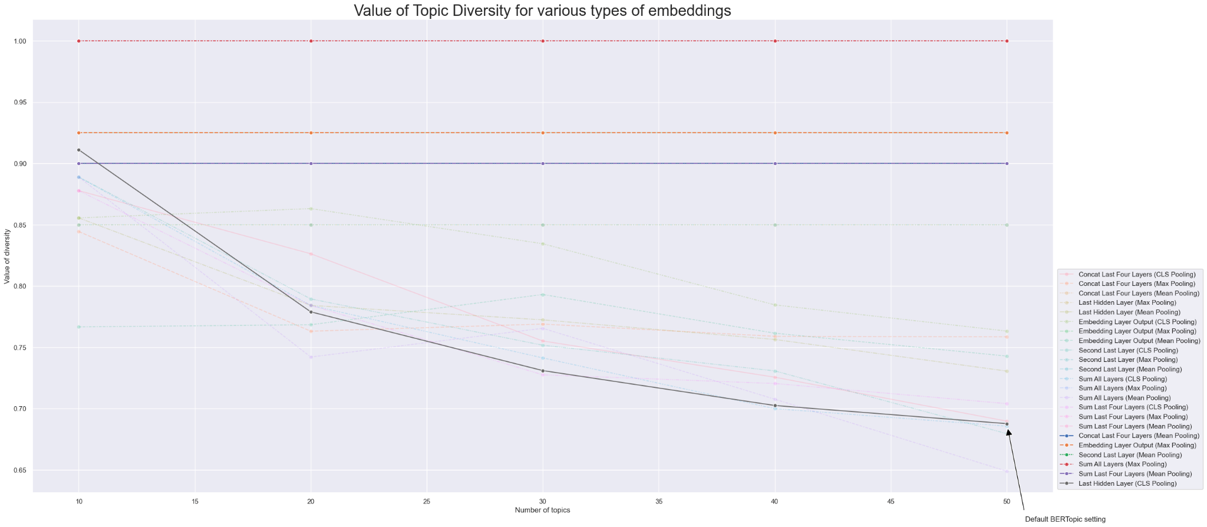
Results on 20 News Groups dataset (2)

Slide 12
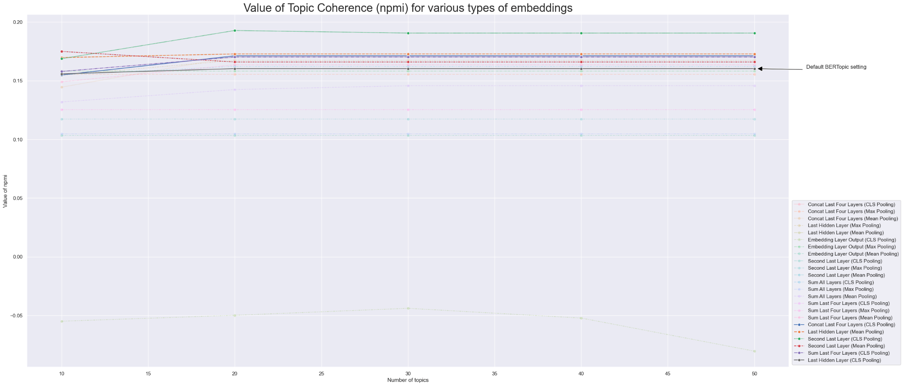
Results on BBC News dataset (1)

Slide 13
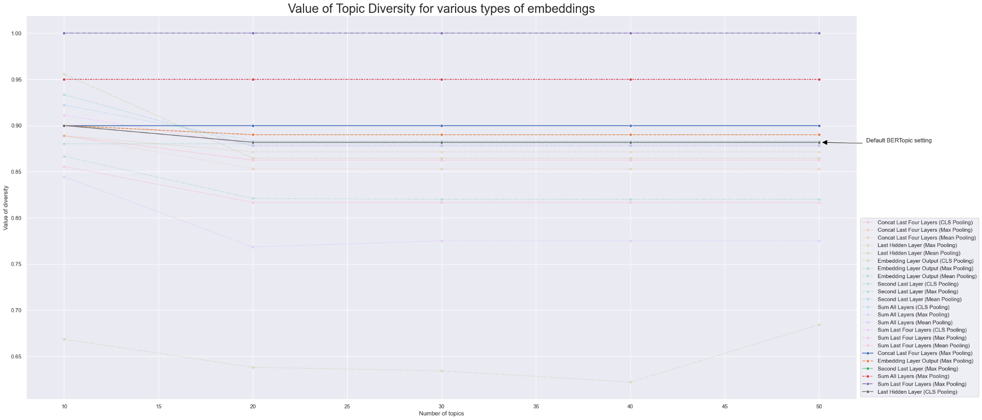
Results on BBC News dataset (2)

Slide 14
Conclusions
Default BERTopic configuration does not guarantee the best value of Coherence or Diversity for any dataset and any number of topics (if we interpret the higher value of diversity as better).
It is useful to explore more possibilities and options when in comes to topic modeling with models based on Transformers.
However, it is costly to explore larger search grid.
It would be beneficial to see how does different pooling strategy behave with different models producing the embeddings.
Big shout-out to free Kaggle Notebooks for making this research possible.

Slide 15
Sources
Ma, Xiaofei, et al. "Universal text representation from bert: An empirical study." arXiv preprint arXiv:1910.07973 (2019).
Hosseini, et al. "Bert has more to offer: Bert layers combination yields better sentence embeddings." Findings of the Association for Computational Linguistics: EMNLP 2023. 2023.
Tsukagoshi, et al. "Comparison and Combination of Sentence Embeddings Derived from Different Supervision Signals." arXiv preprint arXiv:2202.02990 (2022).
Ethayarajh, Kawin. "How contextual are contextualized word representations? Comparing the geometry of BERT, ELMo, and GPT-2 embeddings." arXiv preprint arXiv:1909.00512 (2019).
Puccetti, et al. "How Do BERT Embeddings Organize Linguistic Knowledge?." Proceedings of deep learning inside out (DeeLIO): the 2nd workshop on knowledge extraction and integration for deep learning architectures. 2021.
Reif, Emily, et al. "Visualizing and measuring the geometry of BERT." Advances in Neural Information Processing Systems 32 (2019).
Jawahar, et al. "What does BERT learn about the structure of language?." ACL 2019-57th Annual Meeting of the Association for Computational Linguistics. 2019.
Raganato, et al. "An analysis of encoder representations in transformer-based machine translation." Proceedings of the 2018 EMNLP workshop BlackboxNLP: analyzing and interpreting neural networks for NLP. The Association for Computational Linguistics, 2018.
http://jalammar.github.io/illustrated-bert

